Slide 1
Project Twizy
Software Development Team

Slide 2
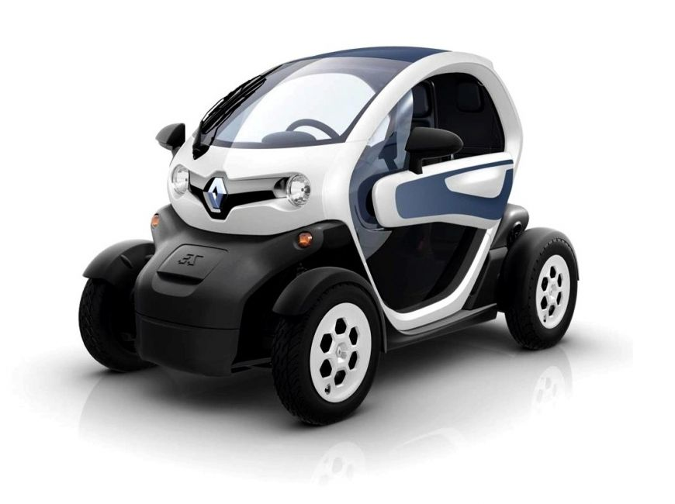

The Team
Vasu - Image Processing Engineer
Feature Extraction & Matching
OpenCV & Java development
Machine Learning Development
Benoit - Software Architect
Project Overview
UML Design
Combination of softwares
Kyle - User Interface Engineer
GUI Design
Networking Backend
Database development

Slide 3
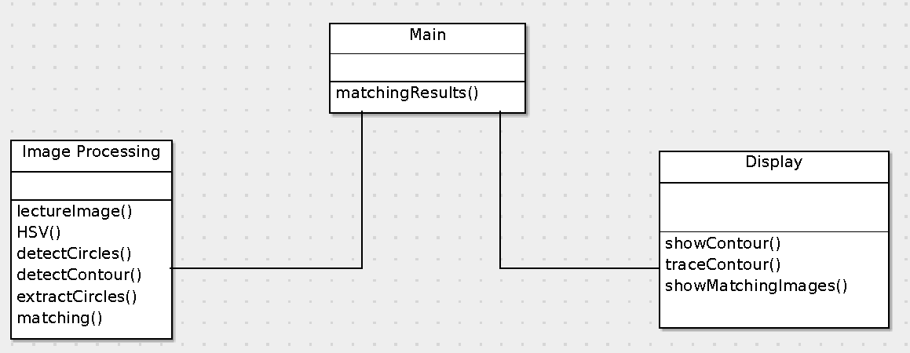
UML Diagram

Slide 4
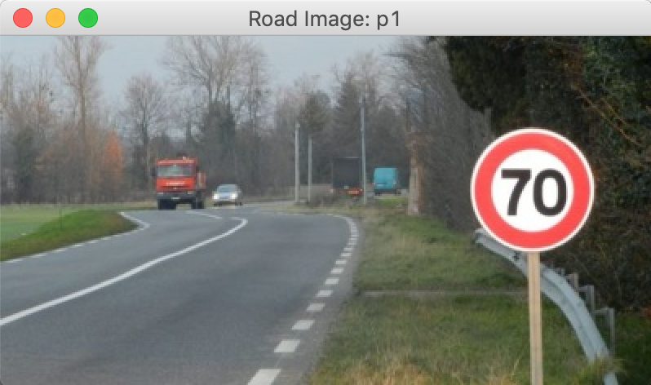
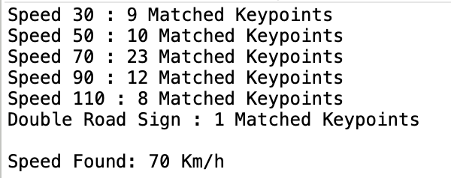
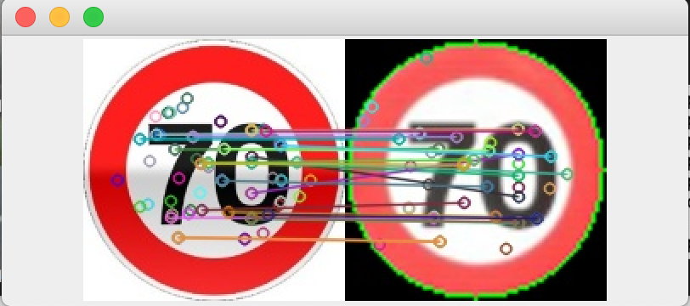
Image Processing and Development
Current Results: Matching Road Signs to Real Life Images and Videos
End Goal: Real Time Data/Video and Processing to Match Road Signs

Slide 5
Project Overview
Possible Components:
UML Diagram - ArgoUML
G.U.I - Java Swing Framework MVC
Image Processing Code - Java OpenCV4
DataBase - SSMS and SQL
Testing - JUnit Test Cases
Version Control - Github
Next Advance Steps:
Machine Learning/Deep Learning
Convolutional Neural Network
Twizy Car Development/Connection

